Slide 1

Linked Structures & Pointers
CISC 610
Data Structures & Algorithms
Brian Grey

Slide 2
What are we doing today?
Variables, generally
Primitives, Pointers, and References
Singly Linked Lists
Basis, Operations, and Efficiency
Doubly Linked Lists
Circularly Linked Lists

Slide 3
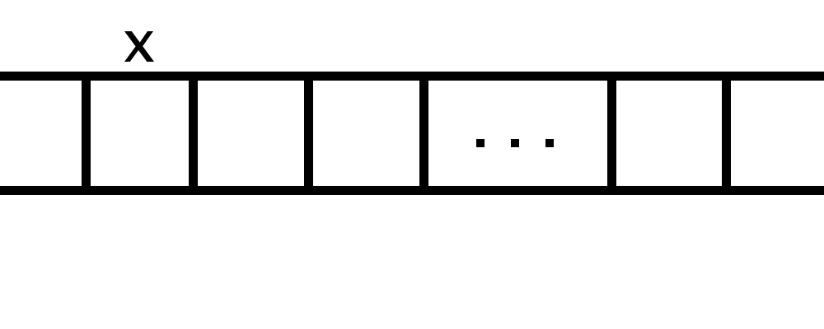
What is a Variable? REALLY?
Suppose you have the following variable declaration:
X = 10
What happens inside of the computer?
But is this complete? Where’s the 10?

Slide 4
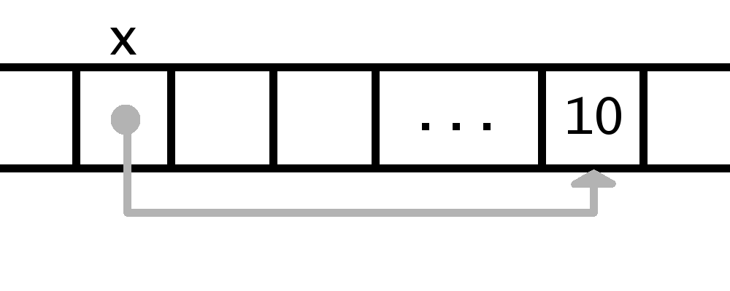
What is a Variable? REALLY?
Suppose you have the following variable declaration:
X = 10
What happens inside of the computer?
The variable name refers to memory address and points at 10
This seems like a pain. Is this universal?

Slide 5
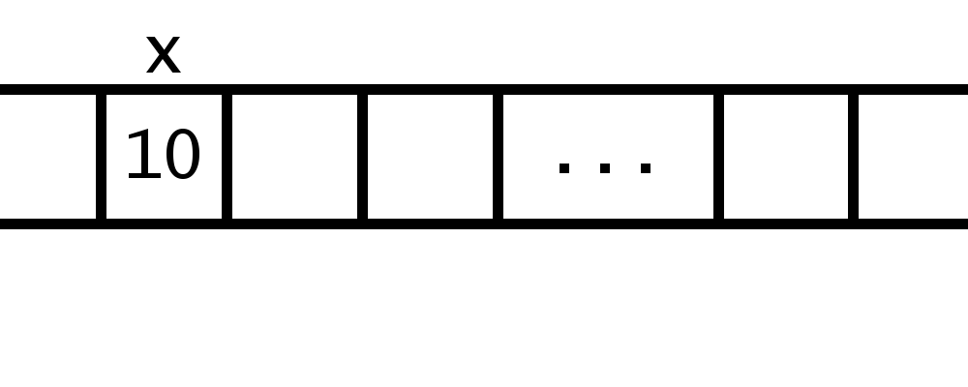
Primitives, Pointers & References
These are the three ways languages can handle variables
Primitives
Stores the information right at the memory address of x
Works great for simple values but not complex objects
Lower and mid-level programming languages may do this for ints, chars, floats, etc.

Slide 6
Primitives, Pointers & References
These are the three ways languages can handle variables
Pointers & References
Instead of storing the value, the language stores a memory address where the value is stored
Pointers and references are largely the same except pointers are treated like any other data
You may type pointer += 4 to move 4 memory addresses up
References store some additional information (variable type) and restrict/protect the programmer
Python & Java use references; C & C++ use pointers

Slide 7
Copying & Passing Variables
What does this mean when copy or pass a variable?
The line x = y means “dump the contents of y into x”
What are the contents?
The memory address of the information y is holding
This is what happens when data is copied
The same happens when arguments are passed into functions
The memory address of the information is sent into the function
Called passing by reference
This allows the function to alter the contents (if possible)

Slide 8
Why talk about this now?
For one, it’s an interesting distinction in computer language structure and architecture
Also, it is extra relevant because when discussing linked/referential data structures
These are compared with arrays or dynamic arrays, which are sequential blocks of memory where data can be found by knowing the starting point and doing some simple math
Starting reference + (block size × index)
One of the reasons computers count from zero!
Many languages have arrays; Python has list and tuple objects

Slide 9
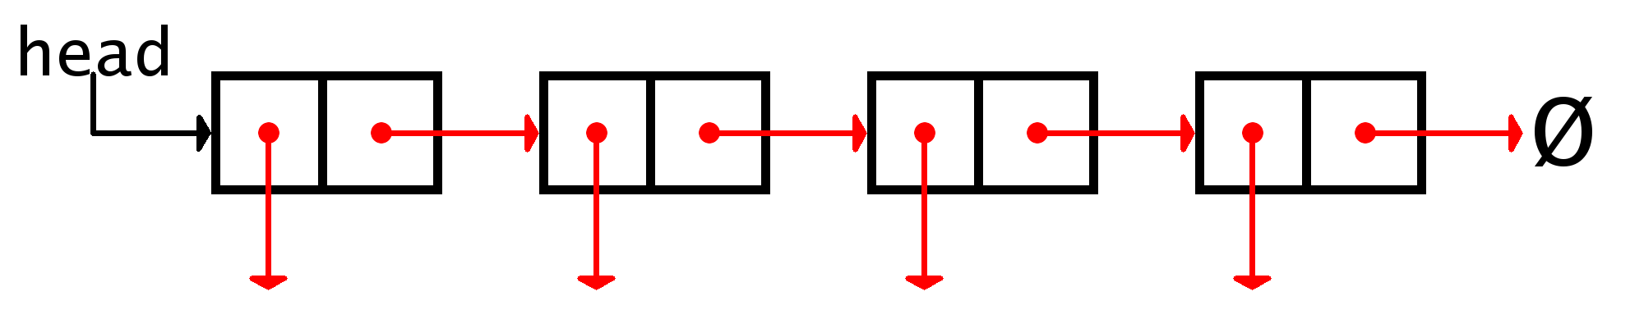
Linked Lists
A concrete data structure consisting of a sequence of nodes
Concrete data structure?
A low-level data structure that is literally implemented as a well-defined solution to a problem
Typically useful for a single purpose OR for use within other data structures
Arrays are another concrete data structure
In fact, linked lists and arrays are alternatives to each other

Slide 10
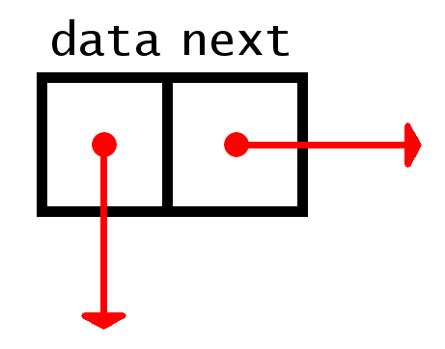
Linked Lists
A concrete data structure consisting of a sequence of nodes
A reference to the head node of the list is all that is needed
What is a node?
A single element of a linked list, similar to a single slot in an array
Contains the element being held and a pointer to the next node
Let’s code it!

Slide 11
Linked List Operations
Like an array, we need to be able to add, remove, overwrite, and access elements in the linked list

Slide 12

Linked List Operations
Like an array, we need to be able to add, remove, overwrite, and access elements in the linked list
Accessing an element in a linked list is trickier than in an array
Recall our structure:
How do we get to the third element?
Iterate from the head
Access is $O(n)$ compared to $O(1)$ for arrays

Slide 13
Linked List Operations
Like an array, we need to be able to add, remove, overwrite, and access elements in the linked list
Two different methods:
Overwrite the element
Replace the node
Overwrite the element is easy:
Get to the desired node
Then call desired_node._element = new_element

Slide 14
Linked List Operations
Like an array, we need to be able to add, remove, overwrite, and access elements in the linked list
Two different methods:
Overwrite the element
Replace the node
Replacing the node is trickier
Get to the node BEFORE desired node
Create a new node with the new element point to the node AFTER the desired node
Point the node before to the new node

Slide 15
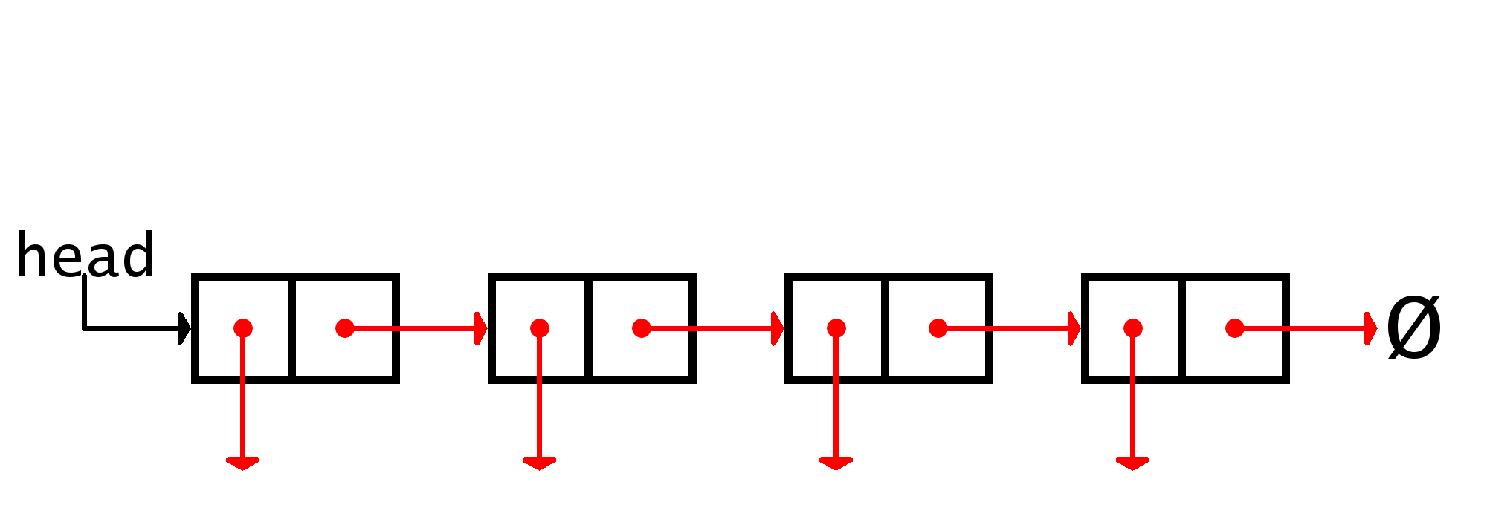
Linked List Operations
Like an array, we need to be able to add, remove, overwrite, and access elements in the linked list
Two different methods:
Overwrite the element
Replace the node
Replacing the node is trickier

Slide 16
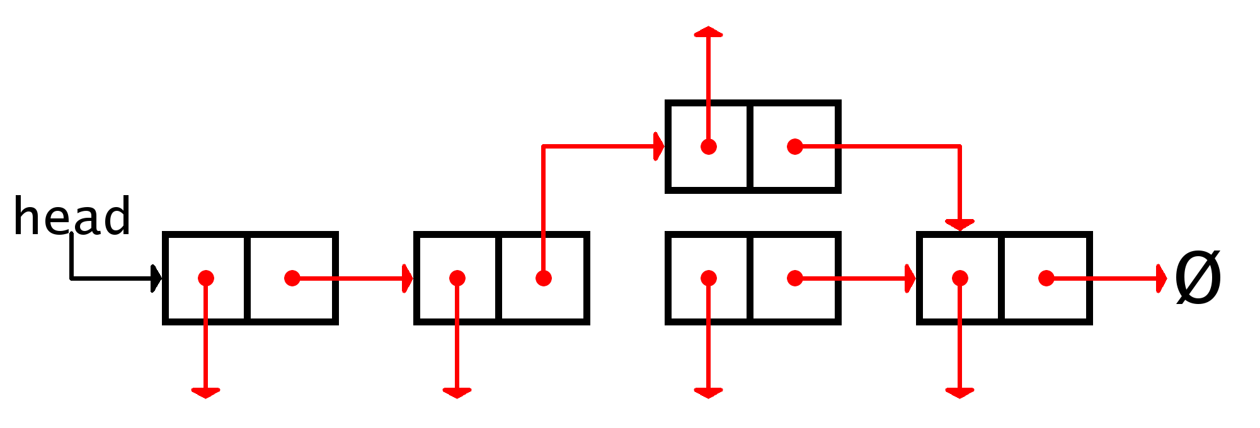
Linked List Operations
Like an array, we need to be able to add, remove, overwrite, and access elements in the linked list
Two different methods:
Overwrite the element
Replace the node
Replacing the node is trickier

Slide 17
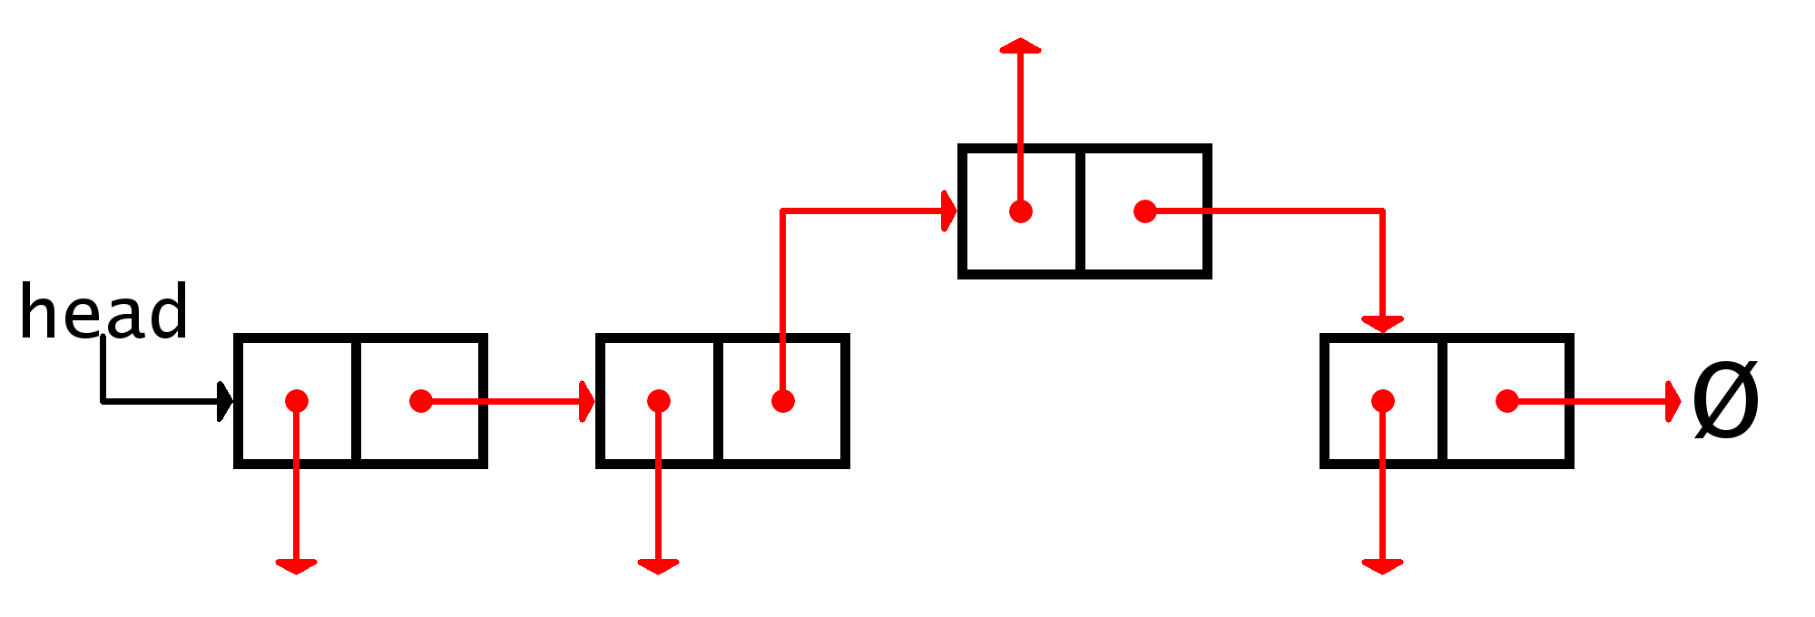

Linked List Operations
Like an array, we need to be able to add, remove, overwrite, and access elements in the linked list
Two different methods:
Overwrite the element
Replace the node
Replacing the node is trickier
Overwrite is $O(1)$ for arrays and both approaches for linked lists

Slide 18
Linked List Operations
Like an array, we need to be able to add, remove, overwrite, and access elements in the linked list
Adding falls into three use cases:
Add to the front
Add to the middle
Add to the end

Slide 19
Linked List Operations
Like an array, we need to be able to add, remove, overwrite, and access elements in the linked list
Add to the front
Create the new node and point it to the current head
Change the head pointer to point to the new node

Slide 20
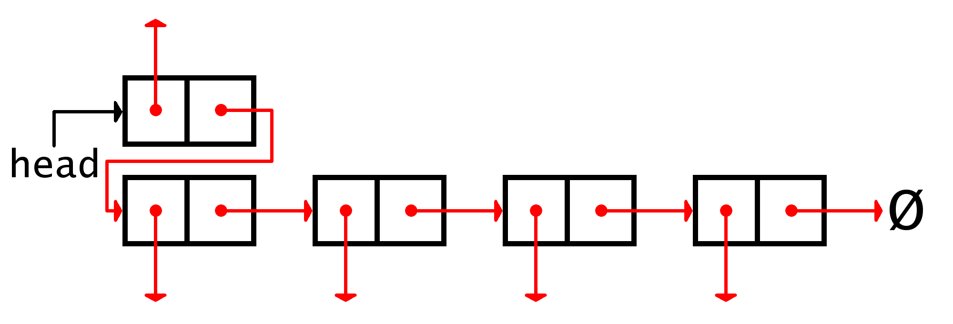
Linked List Operations
Like an array, we need to be able to add, remove, overwrite, and access elements in the linked list
Add to the front
Create the new node and point it to the current head
Change the head pointer to point to the new node

Slide 21
Linked List Operations
Like an array, we need to be able to add, remove, overwrite, and access elements in the linked list
Add to the middle
Similar to the “overwrite by replacement” method
Node before new location points to the new node which points to the node after the location

Slide 22
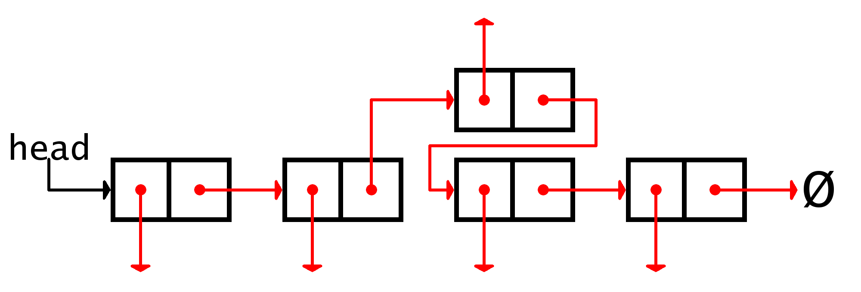
Linked List Operations
Like an array, we need to be able to add, remove, overwrite, and access elements in the linked list
Add to the middle
Similar to the “overwrite by replacement” method
Node before new location points to the new node which points to the node after the location

Slide 23
Linked List Operations
Like an array, we need to be able to add, remove, overwrite, and access elements in the linked list
Add to the end
Find the last node in the list
Create a new node, point the current last node to the new node, and point the new node to None/null

Slide 24
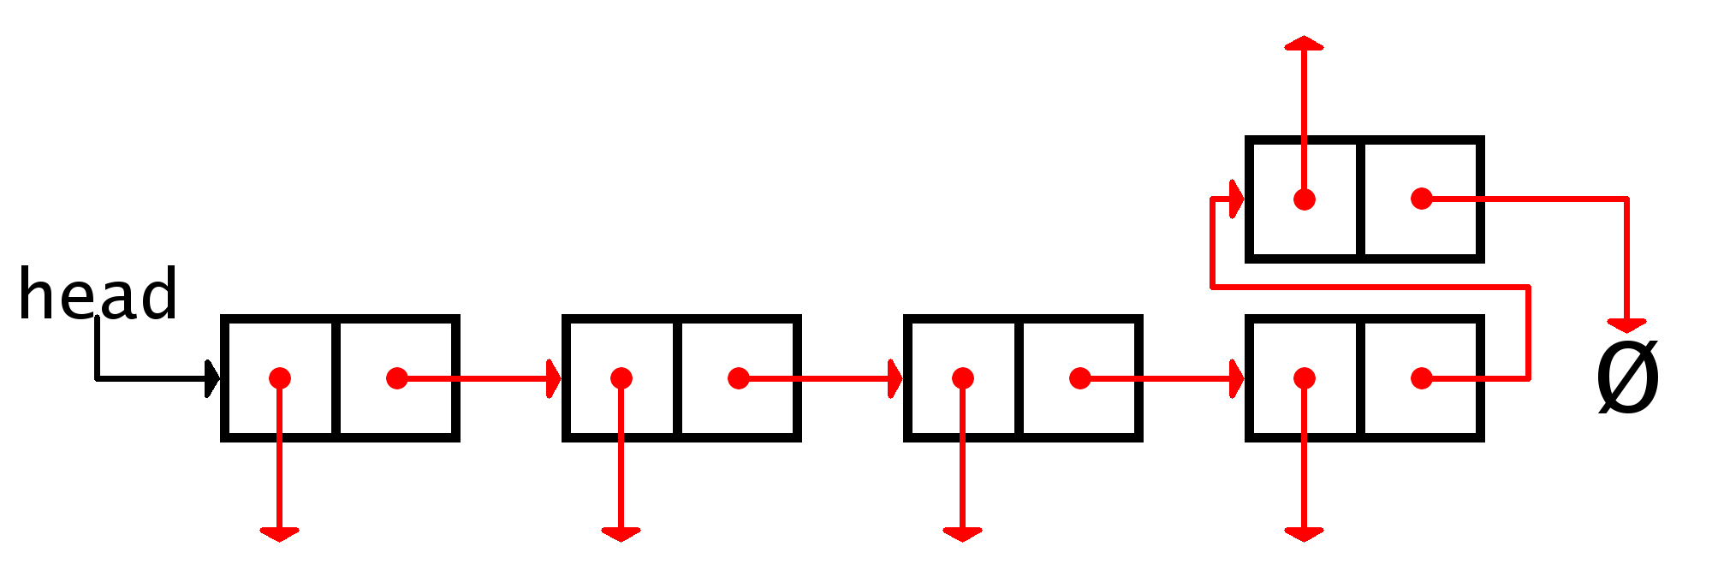
Linked List Operations
Like an array, we need to be able to add, remove, overwrite, and access elements in the linked list
Add to the end
Find the last node in the list
Create a new node, point the current last node to the new node, and point the new node to None/null

Slide 25

Linked List Operations
Like an array, we need to be able to add, remove, overwrite, and access elements in the linked list
Adding is $O(1)$ compared to $O(n)$ for arrays
In an array, all elements must be moved down one position to allow for a new element to be added into the array at index i
(This also ignores the potential slow down of the array having to be resized and expanded)
Simply examining the addition without considering the need to find a position in the linked list, linked lists are much faster
Even considering the access time, linked lists are marginally faster

Slide 26
Linked List Operations
Like an array, we need to be able to add, remove, overwrite, and access elements in the linked list
Removing fits into the same three use cases adding did:
Remove from the front
Remove from the middle
Remove from the end
Processes are the same as adding, only backwards
Additionally, each process might require setting the removed node’s next pointer to None/null and/or destroying the node itself

Slide 27
Linked List Operations
Like an array, we need to be able to add, remove, overwrite, and access elements in the linked list
Remove from the front
Change the head pointer to point to the node after the head
(Set the old head’s next to None/null and destroy the old head)

Slide 28
Linked List Operations
Like an array, we need to be able to add, remove, overwrite, and access elements in the linked list
Remove from the front
Change the head pointer to point to the node after the head
(Set the old head’s next to None/null and destroy the old head)

Slide 29
Linked List Operations
Like an array, we need to be able to add, remove, overwrite, and access elements in the linked list
Remove from the middle
Point the node before the removed node to the one after the removed node

Slide 30
Linked List Operations
Like an array, we need to be able to add, remove, overwrite, and access elements in the linked list
Remove from the middle
Point the node before the removed node to the one after the removed node

Slide 31
Linked List Operations
Like an array, we need to be able to add, remove, overwrite, and access elements in the linked list
Remove from the end
The same as the removing a node from the middle
Find the next to last node, and point it to None/null

Slide 32
Linked List Operations
Like an array, we need to be able to add, remove, overwrite, and access elements in the linked list
Remove from the end
Find the last node in the list
Create a new node, point the current last node to the new node, and point the new node to None/null

Slide 33

Linked List Operations
Like an array, we need to be able to add, remove, overwrite, and access elements in the linked list
Removing is $O(1)$ compared to $O(n)$ for arrays
In an array, all elements must be shifted back one position to ensure that there isn’t a gap in the array at index i
Simply examining the removal without considering the need to find a position in the linked list, linked lists are much faster
What if we consider access time? How does this affect the run time comparisons of linked lists versus arrays removing an element?

Slide 34

So…What if?
What if we’re at “index” 10 but want to go back to “index” 8?
There really are only two options
Iterate again from the head of the list
Could be a $O(n)$ procedure
Maintain a list of trailing nodes that can be “jumped” back to
List can only be finitely long
The longer the list of trailers gets, the more we’re just duplicating the linked list
So, if we’re going to duplicate, let’s do it right

Slide 35
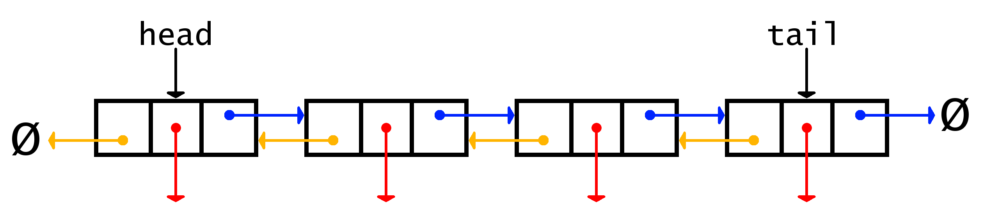
Doubly Linked Lists
A concrete data structure consisting of a sequence of doubly linked nodes
Structured the same as a singly linked list except…
We also have a pointer to the previous node, not just next
End of the list in either direction is when None/null is reached
Let’s code the double node so you can get started

Slide 36
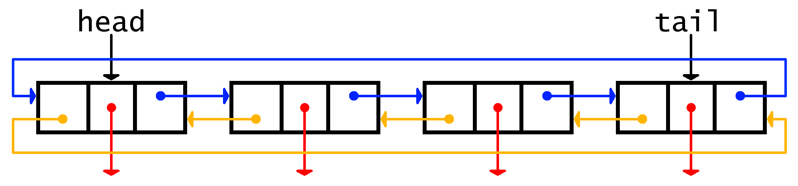
Circularly Linked Lists
A concrete data structure consisting of a sequence of linked nodes where the end links to the beginning (and vice versa if it’s a circularly doubly linked list)
Be careful of infinite iteration!
If current.next == head or tail, you know you’re at a “terminus” and can act accordingly

Slide 37
Questions?

